Slide 1
Artifical Intelligence

Slide 2
Introduction
Can Computers really think
Mimic Human behavior
Turning Test Examples
  Eliza – A short script that reflected their own questions back at them
  Catherine amazingly focus conversation on Bill Clinton only
  Eugen Goostman given persona of a 13 Ukranine boy so interpreted language diffuculties as language and culture barriers
  CleeveBot – Use database of conversations and it has a lack of personality and cannot deal with new topics
Type of AI
  Weak
    Automate tasks to get results quickly and at lower costs
    Ex. Chatbots, Buying recommendations
  Augmented Intelligence
    Helps to make human intelligence better
    Ex IBM Watson for Oncology – Helps to identify key information in a cancer patient’s medical record, but does not choose treatment
  General AI
    ;Whole brain emulation

Slide 3
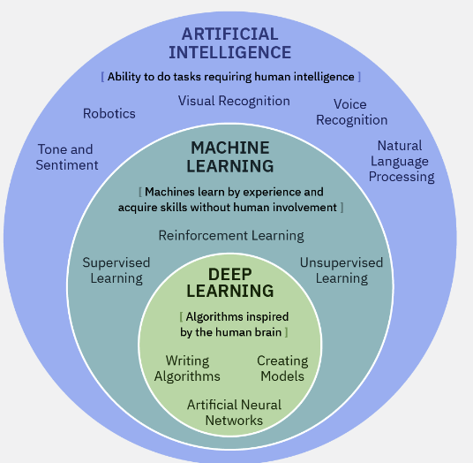
Can Computers Really Think
Types
  Artificial Intelligence
  Machine Learning
    Unsupervised
    Supervised
    Reinforcement
  Deep Learning
    Focuses on statistical model
    requires big data and the cloud
Other technologies important to AI
  Cloud
  Visual recognition
  NLP
  Predictive analysis
  IoT

Slide 4
Artificial Intelligence in Practice
AI Can communicate
  NLP powers chatbots, virtual assistants
AI Can help you do things
  Medical treatments from a machine
    Can read more research publications than a human can
    Can learn from both the publications and research
AI Can solve problems
AI Can play games
AI Can extend human expertise
  Intelligence Augmentation – Development of computerized tools that complement human thinking
  Example – Autodraw

